Slide 1
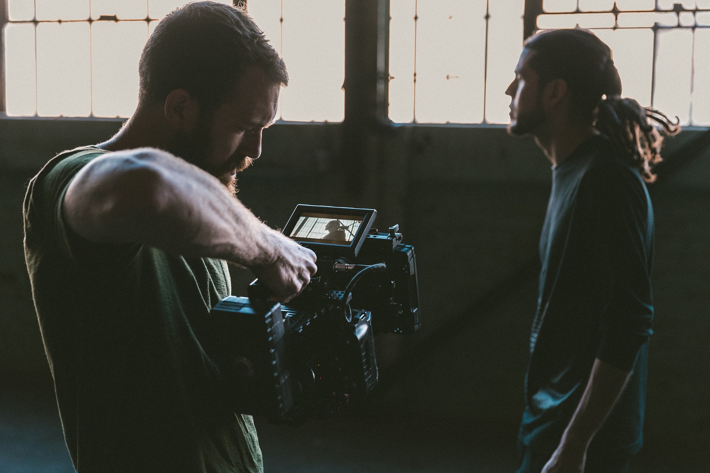

RESETTING CREATIVE PRODUCTION DURING COVID - SOLUTIONS & RESPONSES

Slide 2
We are
THE MARKETING
TRANSFORMATION COMPANY
Marketing Transformation is the process of reinventing an organisational marketing ecosystem, making it fit for the future
Our purpose is to support, inspire and transform the lives of marketeers

Slide 3



FLOCK GLOBAL COVERAGE
LONDON (GLOBAL HQ)
NEW YORK
APAC
EMEA
AMERICAS
SINGAPORE
Flock works globally using the same tools, systems and common Intellectual Property
We often work from clients offices, embedding our staff for a period to join your teams and provide a SPOC (Single point of contact).
For Global assignments we are set up to “chase the sun” and work using global resources to make the most of a near 24 hour working day.

Slide 4


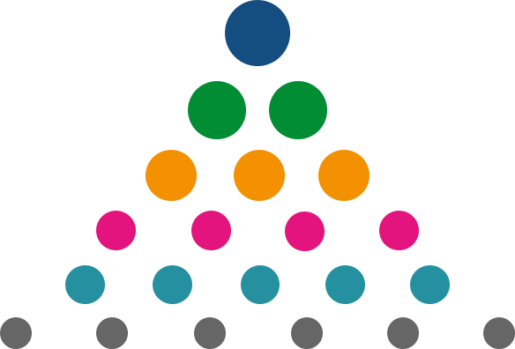


WE DELIVER HOLISTIC MARKETING TRANSFORMATION
AGENCY MANAGEMENT
PEOPLE & SKILLS
MARKETING
TRANSFORMATION
STRATEGY
MEDIA ● CREATIVE ● CONTENT ● PRODUCTION
MARTECH
OPERATIONS

Slide 5
THE FLOCK DIFFERENCE
We are specialists in MARKETING TRANSFORMATION
it’s all we do
Our services are INTEGRATED
and shape
SUSTAINABLE CHANGE
We have run MARKETING TRANSFORMATION assignments at
WORLD LEADING ADVERTISERS
We have run
WORLD LEADING AGENCIES
We have run and participated in OVER 500 GLOBAL REGIONAL
OR LOCAL PITCHES
We have deep
DIGITAL TRANSFORMATION experience
We have specified
MARKETING TECHNOLOGY ecosystems

Slide 6

CREATIVE, CONTENT & PRODUCTION – OUR SERVICES
Flock have deep agency insight & experience and are able to provide expert guidance in transforming your creative, content and production output.
Whether it’s supporting in the decoupling of production, building an in-house content factory or transforming an agency ecosystem. Flock have the experience and knowledge to improve your creative effectiveness.
CREATIVE AGENCY
ECOSYSTEMS
Development and optimisation of the agency ecosystem; how many agencies? Of what type? Producing what? Measured and paid how?
CREATIVE &
PRODUCTION
PITCHES
End to end process for selection of world class agencies, pitches, evaluation/scoring, marketing team support, industry best practice, scoping, selection, transition and measurement.
PRODUCTION
REVIEWS
Full review of the existing production structure, audit of current and future client deliverables, analysis of potential options (decoupling, offshore, in house, etc).
CREATIVE AGENCY
APPRAISAL
Full 360 degree review of agency relationship with the ability to benchmark against the industry in order to identify areas for change.

Slide 7
COVID 19 & THE CREATIVE PRODUCTION ECOSYSTEM

Slide 8



ISSUES THAT COVID-19 HAS CAUSED TO CREATIVE PRODUCTION
Dramatic increase in engagement time on social media and technology in general
Content production issues
Adapt their creative in response to Covid-19
BUT THIS HAS SET A FANTASTIC OPPORTUNITY TO CREATE A NEW FIX

Slide 9





KEY CHALLENGES CREATIVE PRODUCTION FACES
Limited or no access to studios, crew and talent.
Adjusting to working from home whilst also under extreme time pressure to produce content.
Creatively limited to existing assets and repurposing previous work.
Delayed or cancelled productions/shoots.
Reduction in production budgets.

Slide 10
Creative and production have to be closer than ever, in lockstep right out of the gate… This is forcing everyone to be more creative and in the long run we will come out of it having benefited by being open to different solutions and maybe not be as precious as we were on certain things.
John Doris, Head of Production at TBWA

Slide 11
SOLUTIONS & RESPONSES
How Advertisers Are Responding to these Problems

Slide 12







USER GENERATED
CONTENT
INFLUENCER
PRODUCTION
MEDIA OWNER
CONTENT &
PRODUCTION
FACILITIES
USER GENERATED
CONTENT
DIRECT DEALS
WITH PRODUCTION
COMAPNIES
ISOLATED
SHOOTING
ADAPTING EXISTING
FOOTAGE & USING
STOCK FOOTAGE
ANIMATION, CGI AND CAD FILE USE
USER GENERATED
CONTENT
USER GENERATED
CONTENT
IN-HOUSE STUDIO & FREELANCERS
STREAMLINING
CREATIVE
DEVELOPMENT

Slide 13

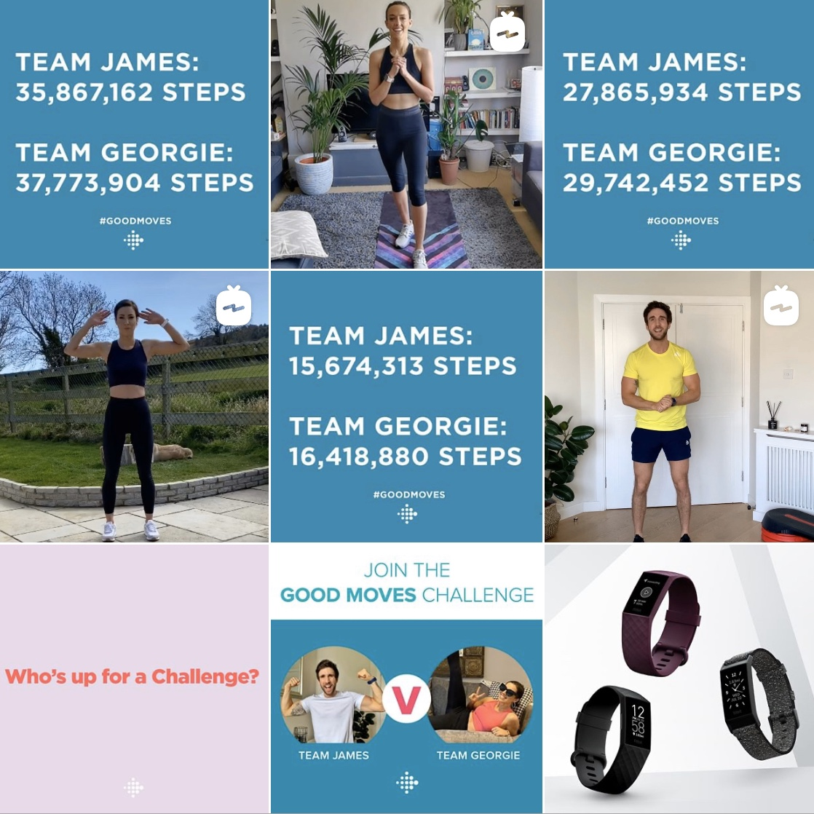
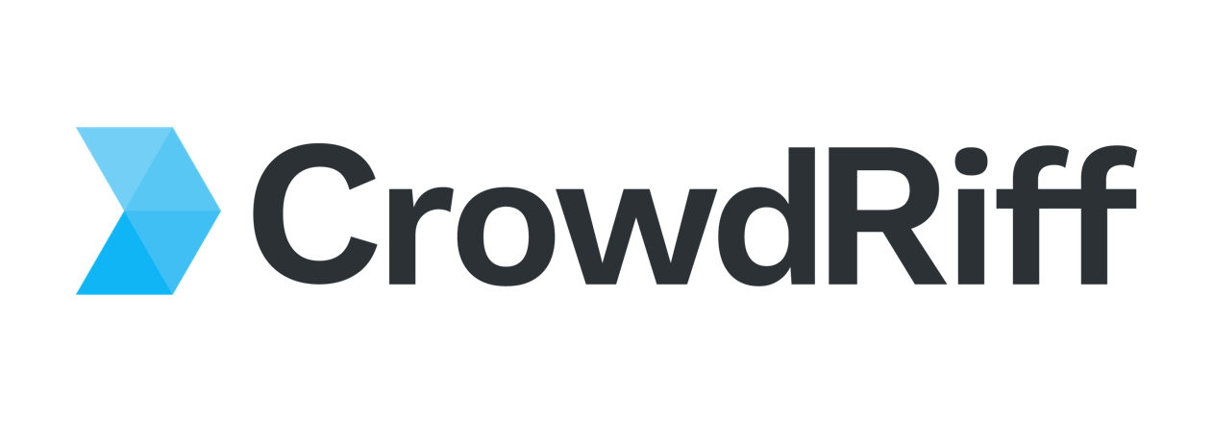
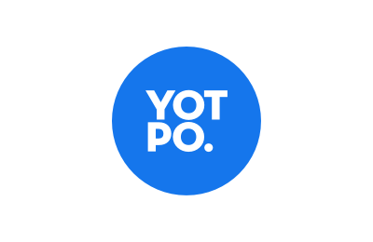

USER-GENERATED CONTENT
With the majority of the population at home during COVID-19, more people are spending time on apps that ever before. Facebook saw a 70% increase in usage of all of its apps in the month of March (eMarketer).
As consumers spend more time on digital platforms many brands are engaging with their customers by encouraging them to produce their own user-generated content.
Examples of user generated content platforms include:
We’re turning to licensing for content footage. Having a creative idea that can be delivered with viral, user-generated content or other licensable footage is surging. In a Santa Margherita wine campaign created by República Havas in the era of COVID, we leveraged viral videos and personal mobile phone footage from the client.”
- Paul Marobella, Chairman & CEO, Havas Creative North America:
FHF's 'Good moves' campaign for Fitbit challenged people to keep active at home and to "celebrate everyone making good moves together", after data from the fitness app found user activity levels had fallen.

Slide 14

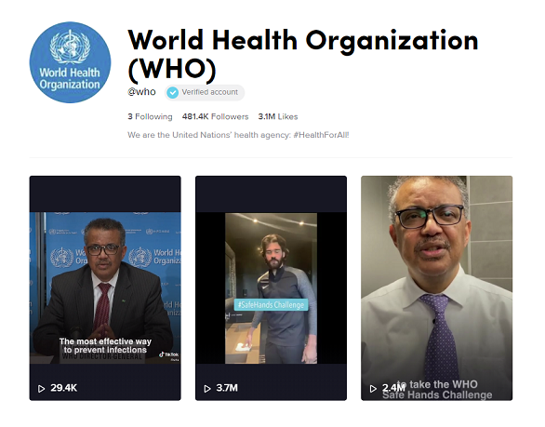
INFLUENCER PRODUCTION
Brands are avoiding creative production companies and going direct to influencers to produce creative assets.
As brands struggle with the financial impact of COVID-19 they are looking for more cost-effective creative. By working with influencers over traditional creative agencies, brands can save themselves thousands of pounds in creative fees.
VISA wanted to raise awareness for health measurements during COVID-19. They briefed their agency BBDO New York who came up with the idea to use Olympic athletes across the world to demonstrate how easy it is to wash your hands compared to conducting their professional sports. BBDO briefed the athletes and instructed them on how to shoot the scenes. eg+ was then able to edit and deploy the content in different formats.
An Obviously (2020) survey of influencers unveiled the following:
33%
  Increase in brands looking to hire influencers to create their photo/video assets.
50%
  Reduction in creative costs on average when working with influencers in place of a production studio.
"Now that COVID-19 is doing the disrupting, brands are looking at influencers for content creation and can't believe how high the quality is, how much better the content performance is, and how much money they are saving.“ - Mae Karwowski, CEO and founder at Obviously
The World Health Organization has partnered with the platform TikTok to help combat the spread of misinformation during the pandemic.

Slide 15

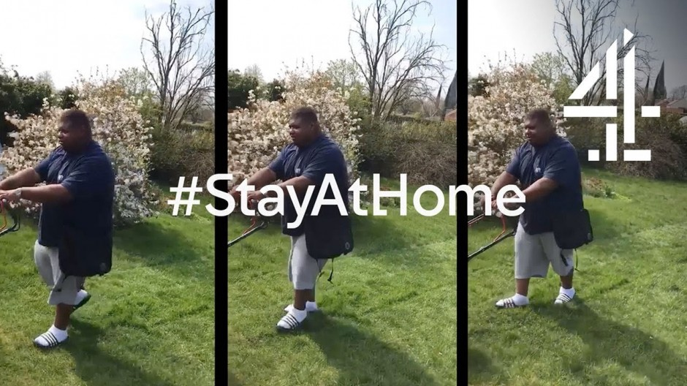
MEDIA OWNER CONTENT AND PRODUCTION FACILITIES
In the absence of abundant production options, advertisers could work with the media owners content and possible use their production facilities.
4Creative, Channel 4’s award winning in-house creative agency developed a series of 10-second films. These were self-shot at home by well-recognised Channel 4 faces to encourage the public health message to 'Stay Home, Save Lives’.
39 advertisers also joined together for the #ClapForOurCarers ad break takeover where they collectively thanked the NHS.
Channel 4 has also recently announced that it will be offering free use of 4Creative and external production partners to advertisers. The broadcaster has seen a 50% decline in ad revenue during April and May and is hoping to keep advertisers on board as the lockdown continues.
“The current limited availability of production services could still be a barrier… We want to remove that barrier by offering this unique, free-of-charge service during this unique time, providing brands access to our internationally renowned 4Creative, and our award-winning production partners.” - Matthew Salmon, Channel 4 Sales Director
The campaign features a variety of clips from Jon Snow ironing his ties to Big Narstie mowing the lawn.
Notes:
Draft text for this page:
https://www.vivendi.com/en/
https://www.bauermedia.co.uk/
https://www.burda.com/en/
https://www.redbullmediahouse.com/en
https://www.itv.com/
https://www.hearst.com/
https://en-gb.facebook.com/
https://www.vice.com/en_uk

Slide 16



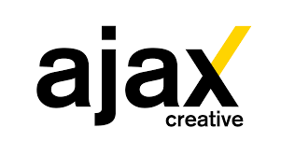










DIRECT DEALS WITH PRODUCTION COMPANIES
By negotiating a deal directly with big production companies, clients are able to work with their teams, use their facilities and content.
There is a vast plethora of content producing agencies to pick from: https://themanifest.com/video-production/agencies

Slide 17

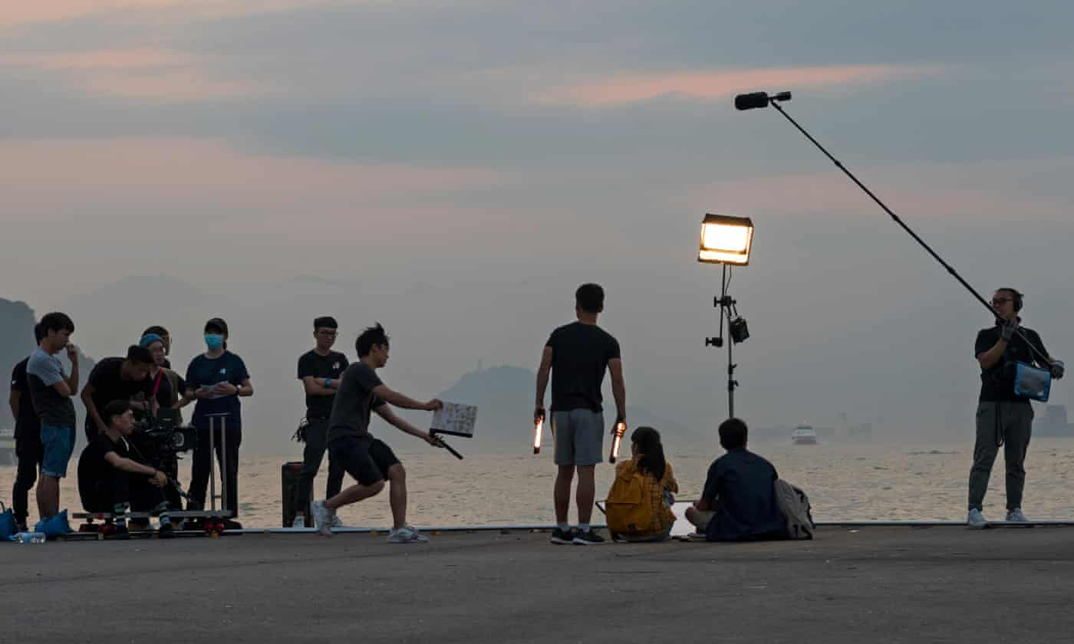
ISOLATED SHOOTING
Some brands and creative agencies are searching globally for locations that have been less effected by COVID-19 or where there are less restrictive lockdowns where they can film and capture new content.
Other creative companies such as Splash are exploring live streaming shoots and other production projects so there's no need for the whole crew to travel.
PSP is reopening it’s production offices in Portugal on 4th May with strict new guidelines to reduce the risk of Coronavirus exposure. These include: Limited crews, livestreaming on set, temperature monitoring on set, constantly sanitising/disinfecting equipment, strict food/beverage services to avoid transmission.
There have been times when a live shoot was necessary. Havas Chicago was asked to expedite an idea for Chicago Mayor Lori Lightfoot’s PSA campaign, ‘Stay At Home, Save Lives.’ As the messaging was very unique to COVID, it was powerful for the Mayor to deliver the message herself, so we sent a three-person crew following social distance guidelines to capture her content.” - Paul Marobella, Chairman & CEO, Havas Creative North America
“As the Coronavirus
dissipates in China, we're slowly starting to see film and content production work return to the Chinese market. Since we’re a global network, we’ve started actively touting the fact that we can leverage our offices in Shanghai to help service the needs of our clients elsewhere in the world.” - Mark Pytlik, CEO, Stink Studios
“Look at crowd-source platforms like Tribe where some creators may have the right kit or be in markets with lighter lockdown restrictions” – Charlie Martyn, Head of New Business Wunderman Thompson
As studios across China slowly begin to reopen suspended film shoots are being restarted. Companies with global production facilities are choosing to relocate to locations where they can resume production.

Slide 18

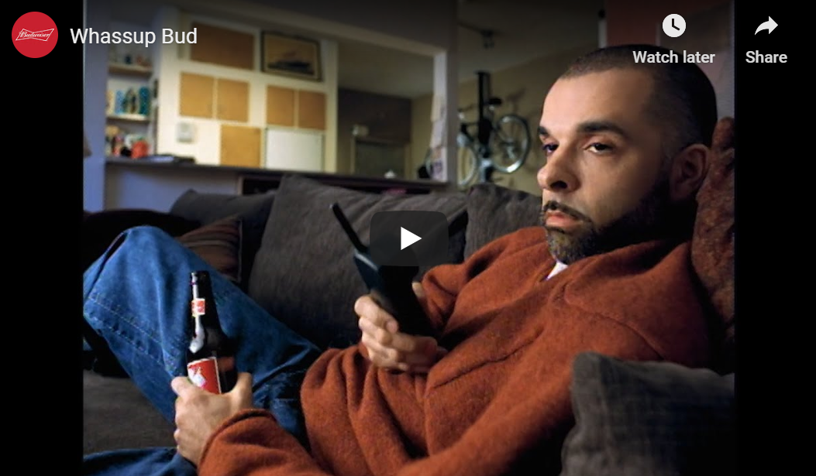
ADAPTING FOOTAGE & USING STOCK FOOTAGE
Shooting new footage is no longer possible, or extremely limited, for many creative production companies so some are looking to make the most of the content they already have.
Much of the content that may have previously been intended for print or OOH can now be converted to be used for digital channels instead.
In addition some companies are relying on stock footage in order to both create campaigns and combine stock footage with existing footage to finalise them. These have come from sites such as Getty Images and Shutterstock.
“Clients immediately shifted to re-versioning existing broadcast, OLV and social content with new animation and graphics produced by Havas and other partners. We’ve unarchived masters and assets from the past few years and ensured everything was accessible remotely.” - Paul Marobella, Chairman & CEO, Havas Creative North America
“To refresh marketing materials, we swiftly adapt existing marketing content through our team of creative production experts… The benefit to the client is they don’t incur the cost of completely reinventing creative or the risk sending the target audience the wrong message during a highly-sensitive time.” - Joanna Carlish, Managing Director, Financial Services, Tag
Budweiser repurposed old footage from its iconic 1999 advert.

Slide 19

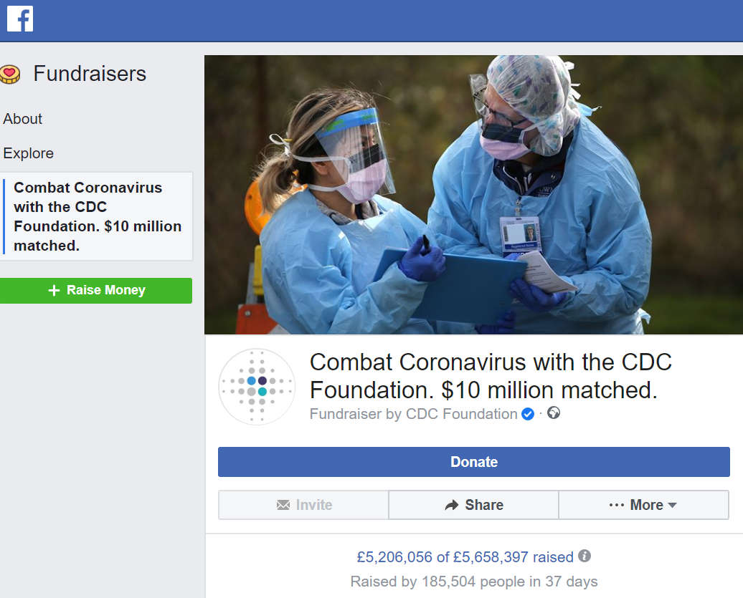
LEVERING ANIMATION, CGI AND CAD FILE USE
The limitations surrounding capturing new footage has led many content production companies to explore using animation instead. When used to best effect it’s an engaging format and unique medium for communicating messages.
“As a result, we create even more CGI environments for generating static and moving assets (walk arounds) for our car clients and we’re also in the process of producing a short promo tag for TV in CGI. We edit and repurpose existing material and by doing that we give creatives additional tools to help them think outside of the box about communication.”
– Tobias Schiwek , Vice President Europe at eg+ worldwide & Designory
“Because the live action pipeline is dry, we’re fielding calls all day long from clients that want to pivot to all post solutions. Requests have been a combination of all animation or stock footage and graphics..” - Jason Mayo, Managing Director and Partner, Bonfire
”We can swap elements of existing photography assets to show your new products. We’re already doing this for a number of partners who are waiting for product samples to be delivered but can’t wait any longer to make progress.” - Paul Stonebridge, Global CEO of Splash
The CDC worked on a PSA campaign that used stock imagery and raised over $6 million in donations on Facebook. Pharmaceutical giant Pfizer has also utilised animation quickly to produce a campaign that included advice and best practices, and modified it for markets around the globe.

Slide 20

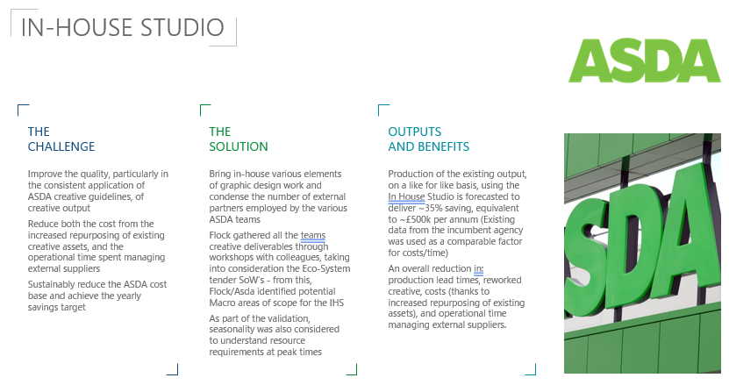
IN-HOUSE STUDIO AND FREELANCERS
Client with In-house studios are the winners of this crisis as the investment pays dividends now.
With safety restrictions in place some campaigns can still be produced in-house.
“Our in-house production teams, ELevel, Social and Labs, have been godsends. Having them already in place has given us uninterrupted access to a full range of production capabilities—shooting, editing, music production and sound mixing as well as creative technology ideas using AR and Deepfake… Over the past two weeks we’ve turned out 18 new ads.” - Margaret Johnson, Partner and Chief Creative Officer, Goodby Silverstein & Partners
“I just don't know where we'd have been without our in-house studio, who were fantastic, they knew exactly what we needed and got it done super fast" - Eilidh Macaskill VP Creative & Media Walmart Asda​
Flock worked with Asda to bring in-house various elements of graphic design work and condense the number of external partners employed by the various Asda teams.

Slide 21

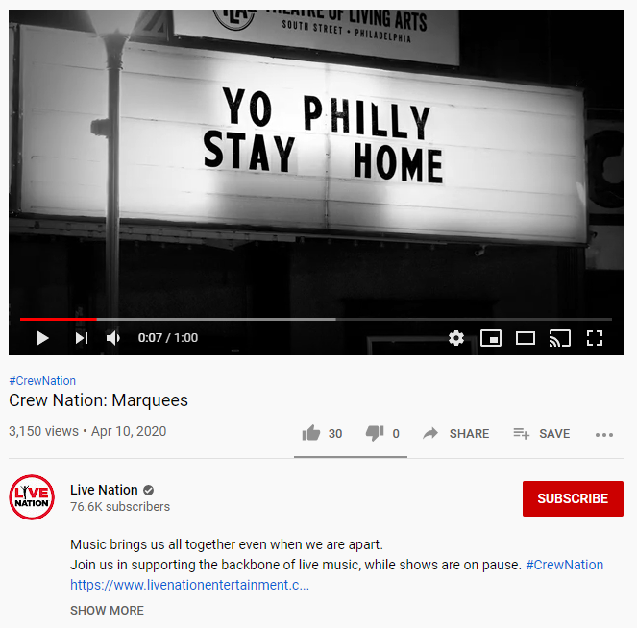
STREAMLINING CREATIVE DEVELOPMENT & PRODUCTION
COVID-19 has resulted in a dramatic Increase in the speed in the production of content some never thought were possible.
The creative process and development of it which once took months and even years is being reduced to a mere few days.
“Producing new scripts at speed, based on stock with additional CGI or animation means they are able to adapt their messages swiftly and efficiently. The long-term impact on consumer loyalty will be based on those brands that were able to react, adapt and innovate appropriately during these strange times.” - David Patton, Global President, Creative Experience and Advertising at Technicolor (The Mill, MPC, Mikros)
"As the way we work has changed, it feels like we have tossed out the rule book. In this case we were rallying around what needed to be achieved, rather than a set process.” - Chris Beresford-Hill, CCO at TBWA/Chiat/Day NY
Live Nation worked with TBWA/Chiat/Day NY to conceptualise, create and execute a new campaign in just 3 days.

Slide 22
FLOCK’S SUGGESTIONS

Slide 23



IDEAS TO CREATE SUSTAINABLE SUCCESS
EDUCATE MARKETERS ON DIFFERENT PRODUCTION TECHNIQUES,
SUPPLIERS AND COSTS
  Interactive webinar training
A REVIEW OF THE PRODUCTION ECOSYSTEM
  Reclassify types of production. Review Rosters.
  Identify skills and capabilities e.g. McDonald’s POM
  Reset suppliers rate-cards
  Balance long and short term contracts
UPGRADE IN-HOUSE CAPABILITIES
  Define; demand, quality, SLA’s
  Decide; business plan, source of funding
  Do; implementation of PROCTD

Slide 24
simon.francis@flock-associates.com

